Slide 1
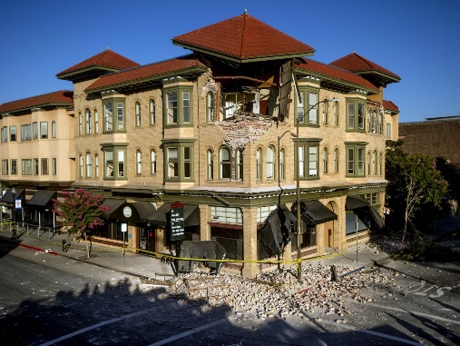
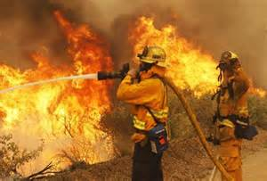
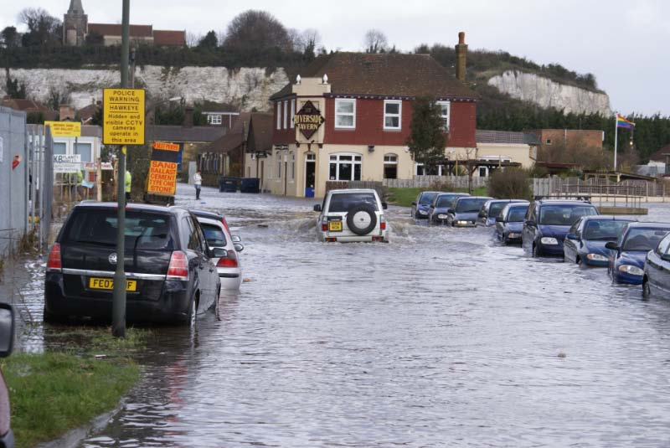
Prepare for an Emergency!
State Council on Developmental Disabilities: North State Regional Office
December 2020

Slide 6
Common emergencies in California
Fires
Floods
Earthquakes
Medical Emergencies

Slide 7
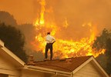
1. FIRES
1.
2.
3.

Slide 8
1. FIRES
Plan two ways out of every room
Check hallways, stairs, doorways, windows and other areas for hazards that may keep you from safely leaving a building during an emergency
Never use elevator during fire
Install smoke detectors. Clean and test monthly. Change batteries yearly
Do not fight fire, get out fast. Call fire department after you are outside. Never go back into burning building
Feel bottom of door with the back of your hand. If hot, don’t open

Slide 9
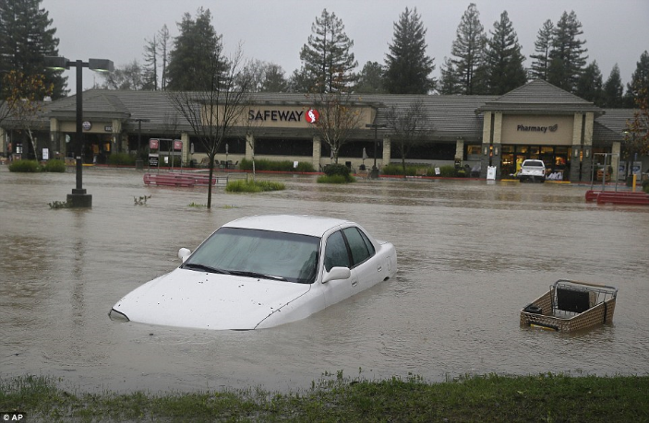
2. FLOODS
1.
2.
3.

Slide 10
2. FLOODS
• See water, turn around!
• Don’t walk or drive through flood waters
• Just 6 inches of moving water can knock you down, and 2 feet of water can sweep your vehicle away
•Avoid camping or parking along streams, rivers, and creeks during heavy rainfall. These areas can flood quickly and with little warning

Slide 11
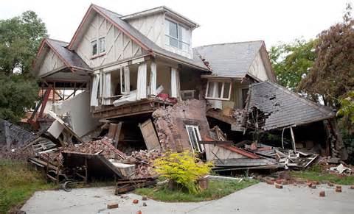
3. EARTHQUAKES
1.
2.
3.

Slide 12
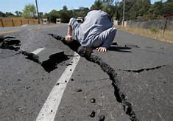
What is he doing?

Slide 13
3. EARTHQUAKES
Find a safe place
Cover head and neck
Hold onto furniture
Do NOT try to get out of building during quake
Drop under table or against inside wall
Don’t try to transfer from bed to wheelchair during quake
Lock wheelchair wheels
If in bed, stay put, cover head/neck with pillow

Slide 14
After an earthquake
Check yourself for injury
Prepare for aftershocks
Look around for hazards
Decide whether you need to evacuate
Otherwise stay put
Remain calm
Follow your disaster plan

Slide 15
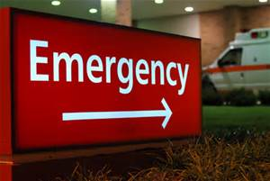
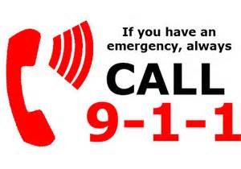
4. MEDICAL EMERGENCY
•Take a deep breath, stay calm
•Call 911
•Tell the operator there's an emergency
•Say your name and where you are (the exact address if you know it)
•Explain what happened and how many people are hurt (The operator will need all the information you can provide, so give as many details as you can)
•Follow all of the operator's instructions carefully
•Stay on the line until the operator says it's OK to hang up

Slide 17
What is an Emergency Plan?
It is a plan, written down, that helps you have all the information you need in one place. It helps you know what to do in care of emergency –
before the emergency happens!

Slide 18
Make a Plan
Make a list of the people who assist you on a daily basis. Know how to contact them
Identify helpful neighbors and friends
Keep family records in a watertight, fire-proof container
Plan alternatives for medical devices or assistance you need (for example: electric wheelchair – manual wheelchair)
Make a plan, write it down
Keep copy of plan in your Emergency Kit
Share a copy of plan with family, friends, care providers

Slide 19
Make a Plan - continued
Decide to stay or go, depending on information and safety
Monitor local conditions
Evacuate (leave) as needed
Stay put or stay with friends
Plan 2 ways out of every room, neighborhood
Make sure more than one exit is wheelchair accessible – if someone in your home uses one

Slide 20
Make a Plan - continued
Practice how to escape from your home in an emergency
Pick one out-of-area and one local friend for family members to call if separated by disaster
Pick two meeting places:
1) A place near home in case of fire
2) A place outside neighborhood in case you can’t return home

Slide 21
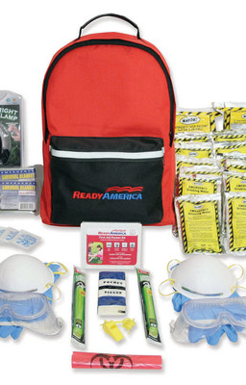
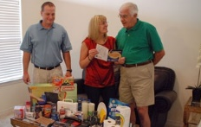
Make a Kit Your needs are unique! What do you need in your kit?

Slide 22
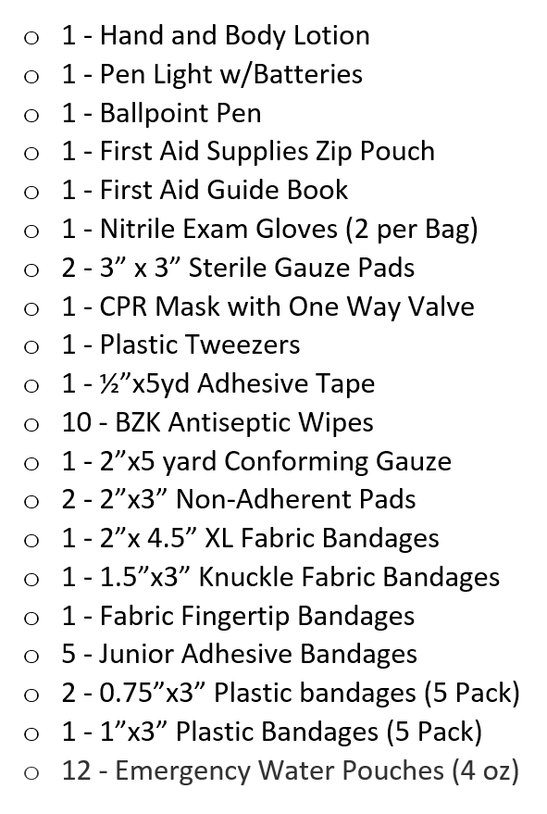
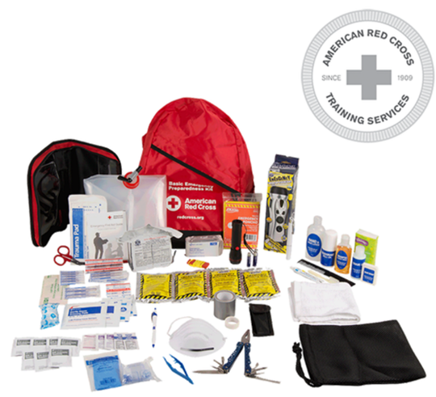

Slide 23
Make the Bag Yours! Put your name and contact information on your name tag. Add contact information for family or staff. Have fun & decorate it. Use permanent marker to write your name and phone number on your red backpack!

Slide 24
What else can you do?
Sign up for local alerts from:
Your county (Google your county name and “emergency alert” and sign up with your phone number
Your local TV or radio station, for example, KCRA.
Your power, gas or electric company (For Example PG&E, SMUD and REU) have programs and information if you use medical equipment

Slide 25
Will you pledge to:
Be Prepared
Make a Plan
Make a Kit

Slide 26
Questions

Slide 27
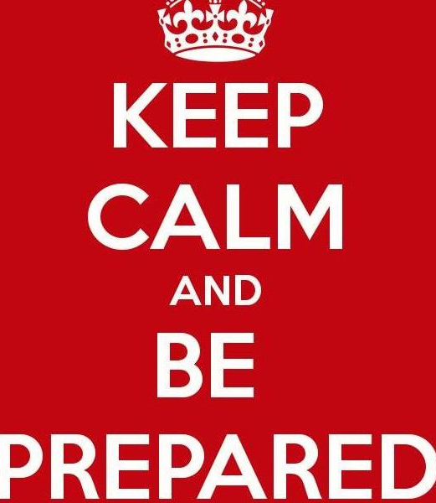
Please complete our training survey.
Thank you and stay safe!!!!!

